Slide 1
Crashing Continents: The Epic Story of Earth's Collision and Separation

Slide 2
Introduction
What is Continental Collision?
The Formation of Mountains
What is Continental Separation?
The Formation of Oceans
Conclusion

Slide 3

Introduction
Welcome to our presentation on continental collision and separation, where we'll explore the powerful forces that shape our planet's surface!
From towering mountains to vast oceans, the Earth is constantly changing as continents collide and separate over millions of years. In this presentation, we'll delve into the fascinating processes behind these transformations and their impact on our world.

Slide 4

What is Continental Collision?
Continental collision is a geological process that occurs when two tectonic plates carrying continents collide with each other. This collision causes the crust to crumple and fold, creating mountains and other landforms. The Himalayas, for example, were formed from the collision of the Indian and Eurasian plates.
The effects of continental collision can be far-reaching. In addition to mountain formation, it can also lead to earthquakes and volcanic activity. It can even cause changes in sea level and climate patterns over thousands of years.

Slide 5
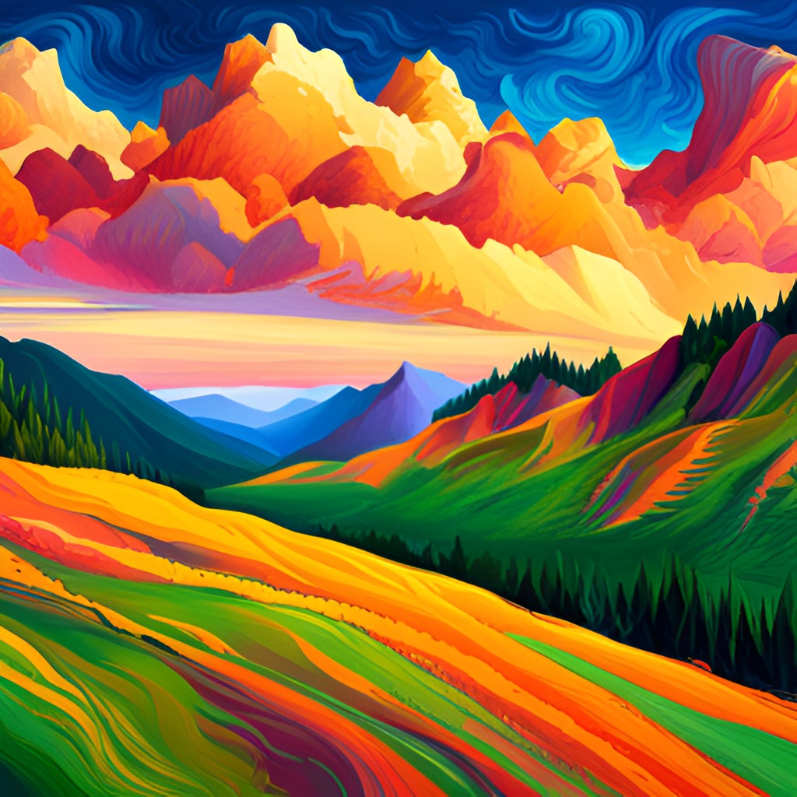
The Formation of Mountains
Continental collision is a geological process that occurs when two tectonic plates carrying continents collide. The force of the collision causes the edges of the continents to crumple and fold, creating mountain ranges.
The formation of mountains due to continental collision can take millions of years. As the plates continue to push against each other, the pressure builds up and causes the rocks to deform and bend. This leads to the formation of folds and faults in the Earth's crust, which ultimately result in the formation of mountains.

Slide 6
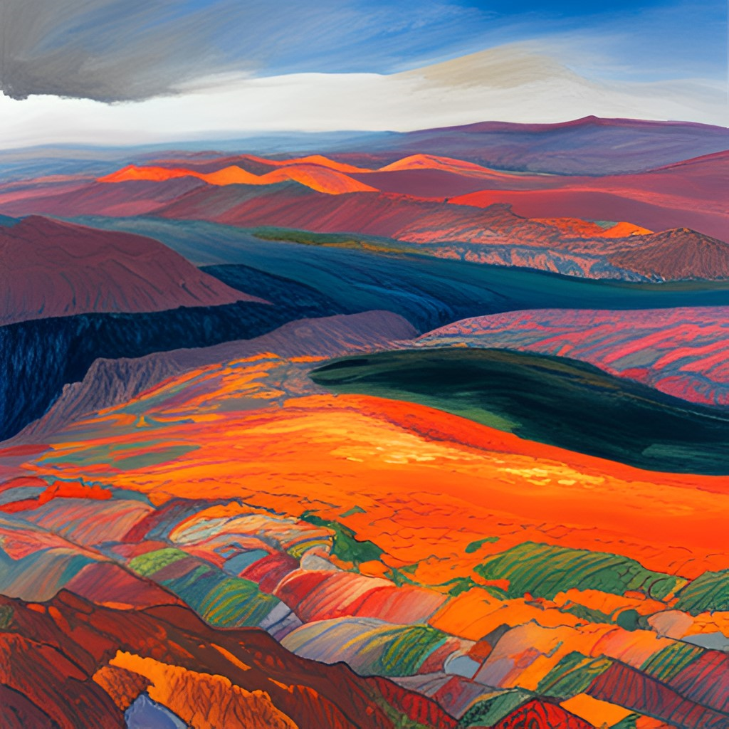
What is Continental Separation?
Continental separation, also known as rifting, is a geological process that occurs when tectonic plates move apart, creating gaps or rifts in the Earth's crust. This process can lead to the formation of new oceans and basins, as well as volcanic activity and earthquakes.
One example of continental separation is the East African Rift System, which is currently splitting the African continent into two separate land masses. Over time, this process could lead to the formation of a new ocean between the two continents.

Slide 7
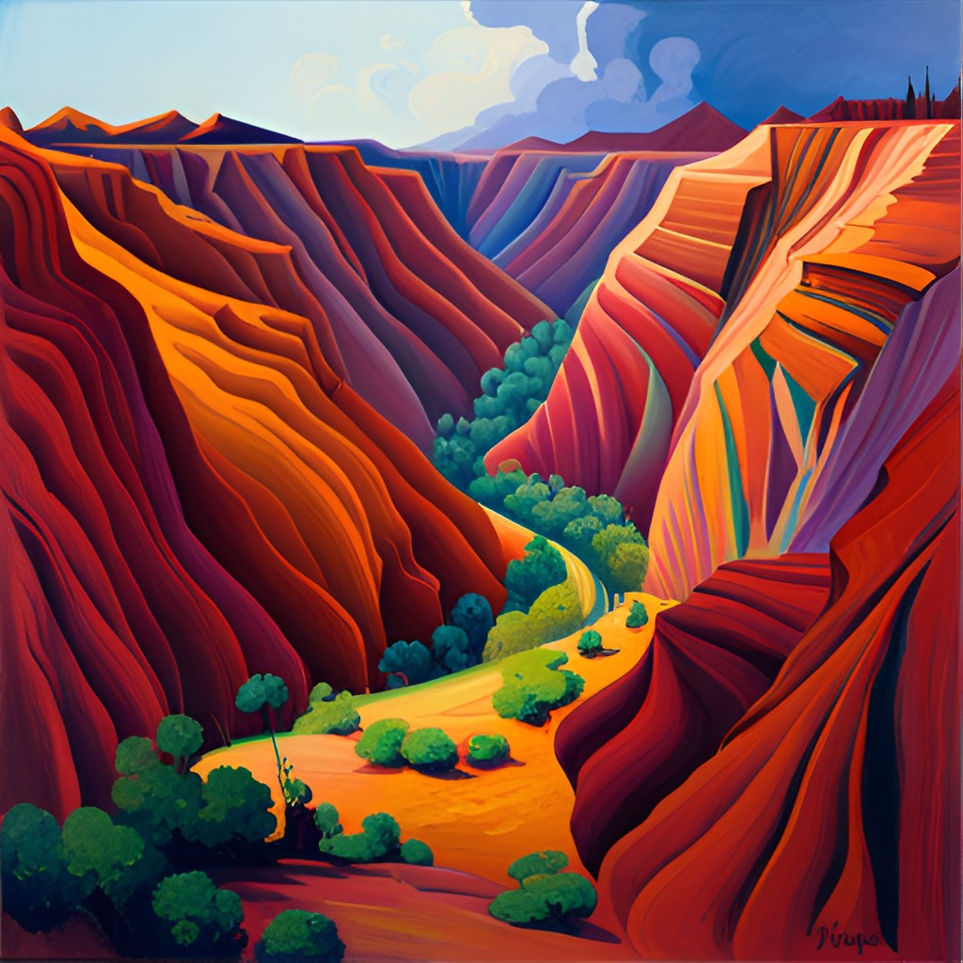
The Formation of Oceans
Continental separation is a process that occurs when two tectonic plates move away from each other, creating a gap or rift between them. This rift can then fill with water, leading to the formation of an ocean.
This process typically occurs over millions of years and is driven by the movement of magma beneath the Earth's surface. As the magma rises up, it creates pressure that pushes the tectonic plates apart, eventually leading to the formation of an ocean basin.

Slide 8
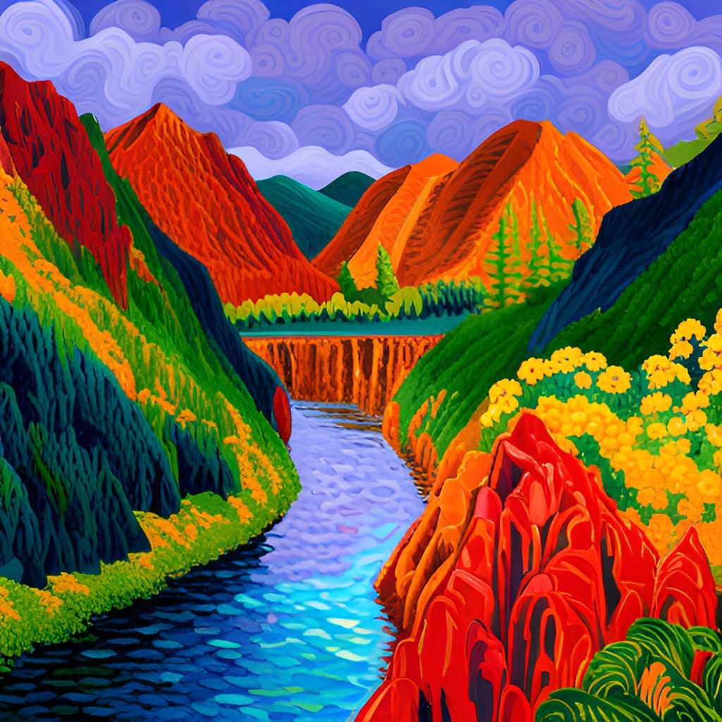
Conclusion
In conclusion, we have learned that continental collision and separation are fundamental geological processes that shape our planet. These processes have profound impacts on the Earth's surface, including the formation of mountains and oceans.
By understanding these processes, we can gain a deeper appreciation for the dynamic nature of our planet and the forces that drive its evolution over time. It is important that we continue to study these processes and their effects in order to better understand our planet and its history.

Slide 9
Credits
Presentation by:
Sam
Narration by:
Surya
Sam
Kenneth
Srivatsan
Sanjay SP
Augustin Luka

